Slide 1
Soy-based Transformer Fluids and
Bio-Fuel Alternatives for Utilities
Opportunities.…. and Challenges
E & O Technical Conference
Sacramento, CA – April 12, 2006

Slide 2
Luis del Valle
Global Marketing Director
Cargill Industrial Oils & Lubricants
15409 McGinty Rd. MS 66
Minneapolis, MN 55439
952-742-4402 Phone
952-742-6722 Fax
luis_delvalle@cargill.com

Slide 3

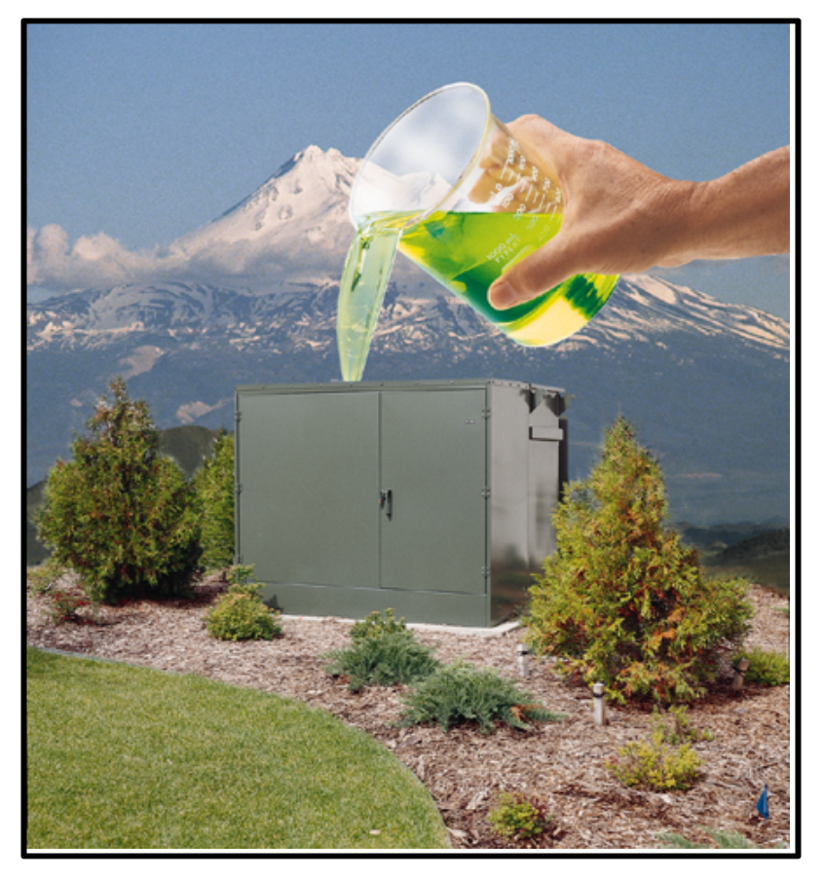
Envirotemp® FR3™Transformer Fluid
Soybean oil based dielectric coolant, commercialized in 1997 after four years of R&D.
  + Fire Safety
  + Extends Transformer Life
  + Environmental Profile
  Made by Cargill.
  Marketed by Cooper.

Slide 4



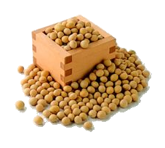
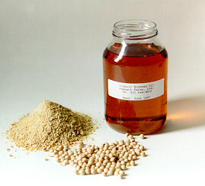

The “Greenest” Dielectric Fluid Possible?
Readily Biodegradable
Non-toxic: Zero trout fry mortality
BEES analysis completed by NIST
Renewable Resource Based (Soybean Oil)
  Meets USDA Bio-Based Products Qualification
Does Not Contain Petroleum,
Dimethlysiloxanes, nor Halogens*
* PCB’s, SF6, CFC, PERC, etc.

Slide 5
Why Use Veg-based Fluids?
Renewable base
Can meet National Electrical Code as “less-flammable liquid”, allowing indoor installation
Substitutes dielectric coolants with negatives
    Naphthenic Mineral Oil: TPH +, fires, supply issues
    Silicone Oil: non-biodegradable, by-products
    HMWH – TPH +, non-renewable
    Halogenated Compounds – Persistence, toxicity,
    GHG, ozone depletion, hazardous thermal by-products

Slide 6
Environmental Technology Verification (ETV)
Conducted and Published by EPA and CalEPA (2002)
Verified:
  Electrical Performance
  Aquatic Biodegradability
  Flammability
  Chemical Composition
  Worker Health and Safety
  Cost Estimate on the Expected Life Using Envirotemp FR3 Fluid v. Mineral Oil

Slide 7
Bio-Fuel Alternatives: Energy Content
btu / lb
Methane 23,885
Natural Gas (US average) 21,000
No. 2 Fuel Oil (diesel) 19,237
Biodiesel (soy-based) 17,830
Tallow 18,500
Lard 16,990
Soybean oil (crude, degummed) 16,900
Wood (dry) 8,600
Glycerin (crude) 6,700
Hulls (sunflower) 5,400

Slide 8
Biodiesel Spec: ASTM D 6751
Property | ASTM Method | Limits | Units
Flash Point | D93 | 130 min. | Degrees C
Water & Sediment | D2709 | 0.050 max | % vol.
Kinematic Viscosity, 40C | D445 | 1.9-6.0 | mm²/sec.
Sulfated Ash | D874 | 0.020 max. | % mass
Sulfur S 15 Grade S 500 Grade | D5453 | 15 max. 500 max. | ppm
Copper Strip Corrosion | D130 | No. 3 max.
Cetane | D613 | 45 min.
Cloud Point | D2500 | Report | Degrees C.
Carbon Residue 100% sample | D4530 (100% sample) | 0.050 max. | % mass
Acid Number | D664 | 0.80 max. | Mg KOH/gm
Free Glycerin | D6584 | 0.020 max. | % mass
Total Glycerin | D6584 | 0.240 max. | % mass
Phosphorous Content | D4951 | 0.001 max. | % mass
Distillation Temp, Atmospheric Equiv Temp, 90% recovered | D1160 | 360 max. | Degrees C.

Slide 9
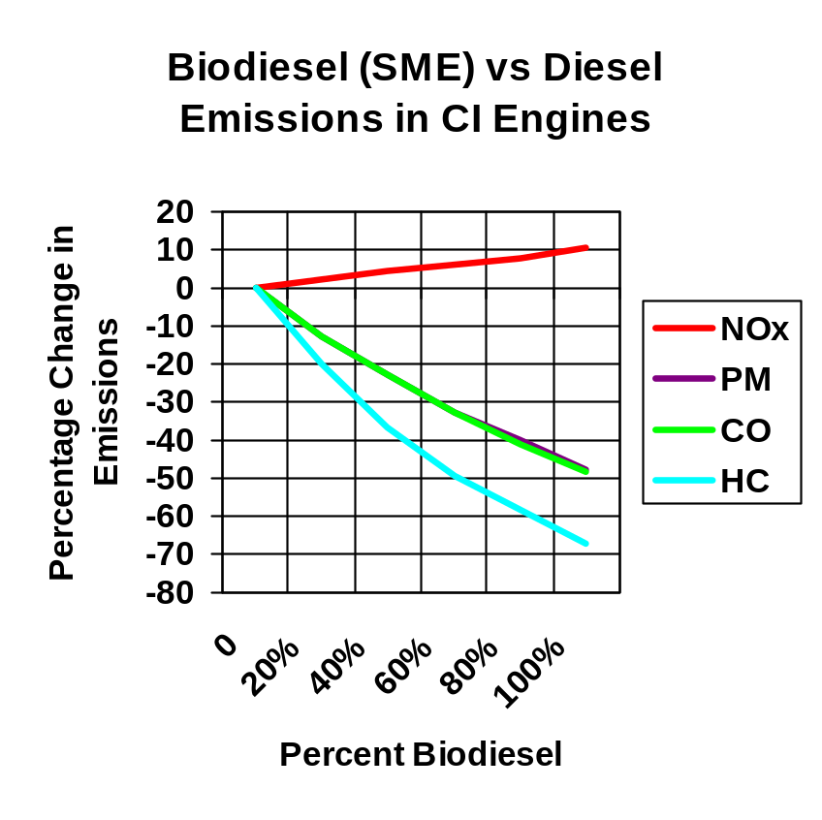
Emissions Benefits of Biodiesel
Carbon dioxide decreases.
  When replacing diesel with B100, CO₂ emissions are reduced 78%; B20 reduces CO₂ by 15.7%.
Reduces tailpipe particulate matter, hydrocarbon and carbon monoxide emissions in most modern four-stroke CI engines.
  Because B100 contains 11% oxygen by weight.
Source: “A Comprehensive Analysis of Biodiesel Impacts on Exhaust
Emissions, (EPA420-P-02_001), www.epa.gov/OMS/models/biodsl.htm

Slide 10
Blending Biodiesel
Biodiesel may be blended with any kind of distillate.
    This includes jet fuel, kerosene, #1 and #2 diesel, or heating oil.
    May be blended via splash blending, in-tank blending, in-line blending.
Biodiesel is slightly heavier than diesel fuel.
    Biodiesel specific gravity of 0.88.
    #2 diesel specific gravity of 0.85.
    #1 diesel specific gravity of 0.80.
Once blended, it will not separate, assuming the fuel is above its cloud point.
    If biodiesel does begin to crystallize or separate, due to its temperature dipping below its cloud point, with heat and agitation it will go back into solution.
Source: NREL, “2004 Biodiesel Handling and Use Guidelines”

Slide 11
Handling Biodiesel (B100)
Biodiesel is a solvent.
    May loosen and/or dissolve diesel sediment found in existing fuel tanks and fueling systems.
Cloud point is higher than diesel.
    Insulated and heated lines and/or tanks may be required, depending upon climate.
    It is recommended that B100 be stored 5-10ºF higher than the cloud point.
B100 is not compatible with certain types of rubber compounds, causing premature degradation.
    Biodiesel resistant materials, such as Viton™, fluorinated polyethylene and propylene, Teflon™ and most fiberglass, are available.
Biodiesel is not compatible with some metals and plastics.
    Will form high sediment levels when in contact for extended periods of time with copper, brass, bronze or galvanized surfaces.
    Will degrade typical plastics (i.e. polyethylene, polypropylene).
    Stainless steel, carbon steel, or aluminum, are recommended for storing B100.
National Biodiesel Board recommends storing B100 for no longer than 6 months.
Source: NREL, “2004 Biodiesel Handling and Use Guidelines”

Slide 12
Biodiesel Tax Incentives: Federal
$1.00/gal excise tax credit for blended biofuels effective Jan 2005 thru Dec 2008.
    $0.50/gal credit for non-virgin oils.
    Heating oil blended with biodiesel is also eligible.
$0.10/gal tax credit for small agri-biodiesel blenders.
    “Small producer” must have less than 60 MGPY biodiesel capacity.
    Tax credit eligible for the first 15 MGPY product.
Other programs to encourage demand and infrastructure development.
For more info: www.biodiesel.org

Slide 13
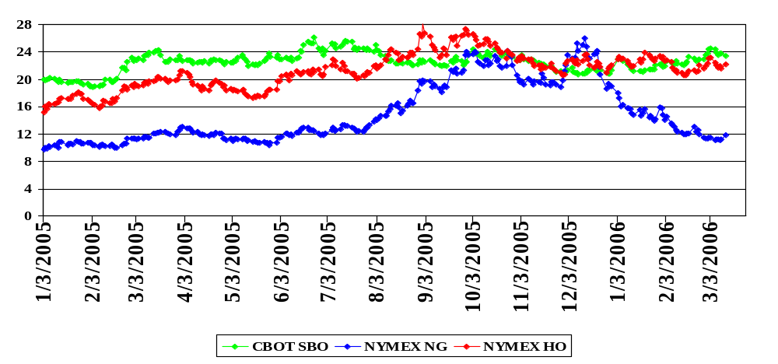
Comparison of Soybean Oil, Natural Gas and Heating Oil (Respective nearby futures in cts/lb BTU equivalency)
Post-Hurricanes Spike

Slide 14
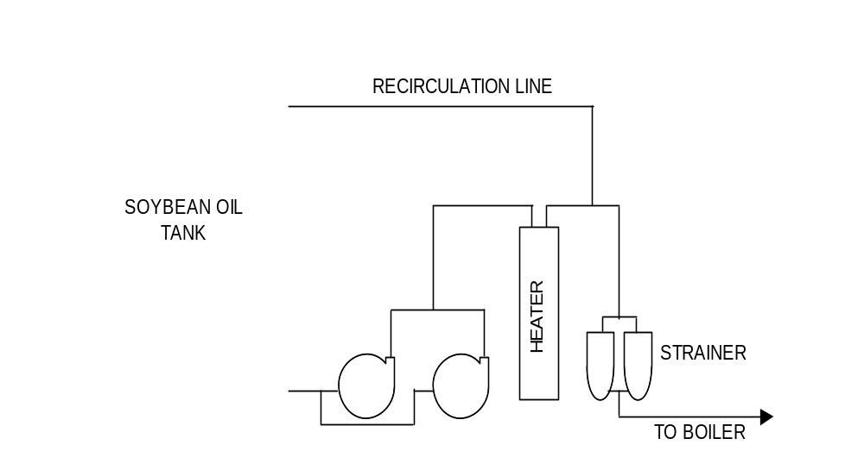
Soybean Oil General Schematic

Slide 15
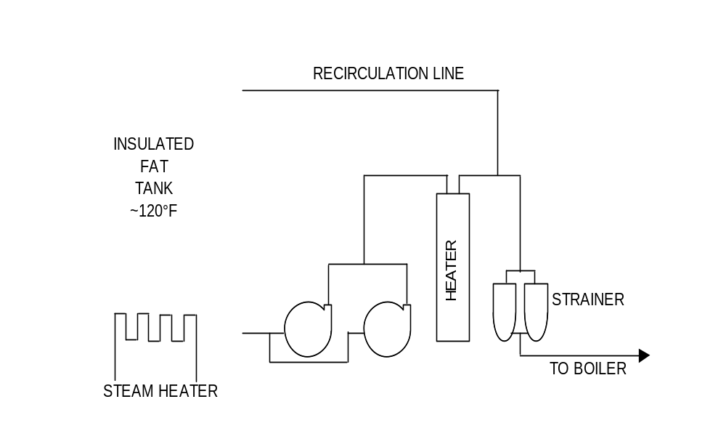
Animal Fats General Schematic

Slide 16
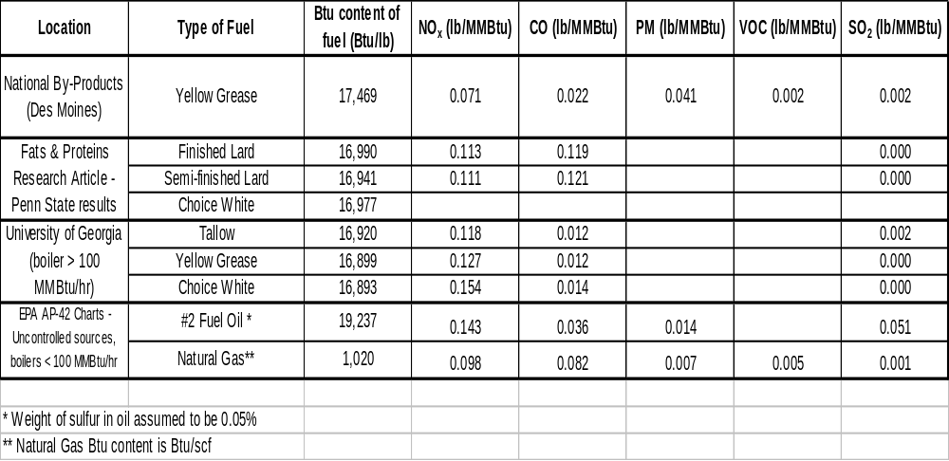
Emissions from Grease Burning Tests
Burning of fats and oils in industrial boilers usually requires new or revised EPA permits given the
different emissions profiles versus natural gas and/or fuel oil.

Slide 17
Additional Considerations for Burning Fats and Oils
Optimal burn requires de-gummed veg-oil or polished fats.
    Crude fats/oils work, however, nozzles will “gum-up” quickly.
Glycerin:
    Salts in crude glycerin a problem
Additional infrastructure may be required.
    Unloading, storing in-bound fats / oils.
    Heat-trace lines and / or tanks.
    Re-circulating fats / oils.

Slide 18
De-gummed Soybean Oil
    Heat to 165-175°F to the burner.
    110-120 psig to the burner.
    When oil is <25°F, recirculate it through heater until tank is at least 50°F.
Animal Fat
    Same temp and pressure to the burner?
    Heater in fat tank keeps it at 120-140°F.
Thank you for your time today. Any questions?

